Slide 1
UNIT 1 INTRODUCTION

Slide 2
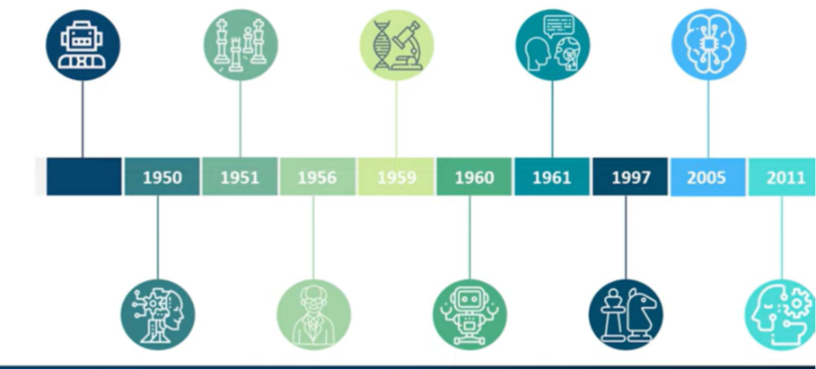
History of AI

Slide 3


Slide 26
Introduction to Intelligent Agents
Intelligent Agents can be any entity or object like human beings, software, or machines.
These agents can make decisions based on the inputs from the environment using its sensors and act on the environment using actuators.
AI-Enabled agents collect information from the environment using sensors like cameras, microphones, or other sensing devices. Then, the agents perform some real-time computation on the input and deliver output using actuators like screens or speakers.
These agents have abilities like Real-Time problem-solving, Error or Success rate analysis, and information retrieval.
Goals of Intelligent Agents
High Performance
Optimized Result
Rational Action

Slide 27
Three Forms of Intelligent Agent
Human-Agent
Robotic Agent
Software Agent

Slide 28
1. Human-Agent: A Human-Agent use Eyes, Nose, Tongue, and other sensory organs as sensors to percept information from the environment and uses limbs and vocal tract as actuators to perform an action based on the information
2. Robotic Agent: Robotics Agent uses cameras and infrared radars as sensors to record information from the Environment. It uses reflex motors as actuators to deliver output back to the environment.
3. Software Agent: Software Agents use keypad strokes, audio commands as input sensors, and display screens as actuators.
For Example– AI-based intelligent assistants like Siri and Alexa. They use voice sensors to request the user’s request and search for the relevant information in secondary sources without human intervention, and actuators like their voice or text module relay information to the environment.

Slide 29
The Functions of an Artificial Intelligence Agent
Artificial Intelligence agents perform these functions continuously:
Perceiving dynamic conditions in the environment
Acting to affect conditions in the environment
Using reasoning to interpret perceptions
Problem-solving
Drawing inferences
Determining actions and their outcomes

Slide 30
The Structure of Agents in Artificial Intelligence
Agents in Artificial Intelligence follow this simple structural formula:
Architecture + Agent Program = Agent
These are the terms most associated with agent structure:
Architecture: This is the machinery or platform that executes the agent.
Agent Function: The agent function maps a precept to the Action, represented by the following formula: f:P* - A
Agent Program: The agent program is an implementation of the agent function. The agent program produces function f by executing on the physical architecture.
Many AI Agents use the PEAS model in their structure. PEAS is an acronym for Performance Measure, Environment, Actuators, and Sensors. For instance, take a vacuum cleaner.
Performance: Cleanliness and efficiency
Environment: Rug, hardwood floor, living room
Actuator: Brushes, wheels, vacuum bag
Sensors: Dirt detection sensor, bump sensor

Slide 31
Types and Rules of Intelligent Agents
These Agents are classified into five types based on their capability range and extent of intelligence.

Slide 32
Simple Reflex Agents
They are the basic form of agents and function only in the current state.
They have very low intelligence capability as they can’t store past state.
These types of agents respond to events based on pre-defined rules, which are pre-programmed.
They perform well only when the environment is fully observable.
Thus, these agents are helpful only in a limited number of cases, like a smart thermostat.
Simple Reflex Agents hold a static table from where they fetch all the pre-defined rules for acting.

Slide 33
2. Model-Based Agents
It is an advanced version of the Simple Reflex agent.
Like Simple Reflex Agents, it can also respond to events based on pre-defined conditions; on top of that, it can store the internal state (past information) based on previous events.
Model-Based Agents update the internal state at each step.
These internal states aid agents in handling the partially observable environment.
It relies on both the internal state and current percept to perform any action.
However, it is almost impossible to find the exact state when dealing with a partially observable environment.

Slide 34
3. Goal-Based Agents
These agents’ actions depend on the distance from their goal (Desired Situation).
The actions are intended to reduce the distance between the current and desired states.
To attain its goal, it uses the search and planning algorithm.
One drawback of Goal-Based Agents is that they don’t always select the most optimized path to reach the final goal.
This shortfall can be overcome by using Utility Agent.

Slide 35
4. Utility Agents
The action taken by these agents depends on the end objective, so they are called Utility Agents.
Utility Agents are used when there are multiple solutions to a problem, and the best possible alternative must be chosen.
The alternative chosen is based on each state’s utility.
Then, they perform a cost-benefit analysis of each solution and select one to achieve the minimum cost goal.

Slide 36
5. Learning Agents
Learning Agents have learning abilities to learn from their past experiences.
These agents can start from scratch and, over time, acquire significant knowledge from their environment.
The learning agents have four major components which enable them to learn from their experience.
Critic: The Critic evaluates how well the agent performs vis-à-vis the set performance benchmark.
Learning Elements: It takes input from the Critic and helps the Agent improve performance by learning from the environment.
Performance Element: This component decides on the action to improve performance.
Problem Generator: The problem Generator takes input from other components and suggests actions resulting in a better experience.

Slide 37
Rules
There are a few rules agents must follow to be termed Intelligent Agents.
Rule 1: The Agent must be able to percept information from the environment using its sensors.
Rule 2: The inputs or observations collected from the environment should be used to make decisions.
Rule 3: The decision so made from the observation should result in some tangible action.
Rule 4: The action taken should be rational.

Slide 38
Structure of Intelligent Agent
The Intelligent Agent structure combines Agent Function, Architecture, and Agent Program.
Agent = Architecture + Agent Program
Architecture:
Architecture is the machinery on which the agent executes its action. It is essentially a device with embedded actuators and sensors.
Example: Autonomous cars, which have various motion and GPS sensors attached to them and actuators based on the inputs, aid in actual driving.
2. Agent Function:
Agent Function helps in mapping all the information it has gathered from the environment into action
3. Agent Program:
The Agent Program performs the execution of the Agent Function. The execution happens on top of Agent Architecture and produces the desired function.

Slide 39
The end goal of any agent is to perform tasks that otherwise must be performed by humans. Thus, agents act like intelligent assistants who can enable the automation of repetitive tasks, help in data summarization, learn from the environment, and make recommendations for ­­the right course of action, which will help reach the goal state.

Slide 40
PEAS in artificial intelligence
PEAS stands for performance measure, environment, actuators, and sensors. PEAS defines AI models and helps determine the task environment for an intelligent agent.
Performance measure: It defines the success of an agent. It evaluates the criteria that determines whether the system performs well.
Environment: It refers to the external context in which an AI system operates. It encapsulates the physical and virtual surroundings, including other agents, objects, and conditions.
Actuators: They are responsible for executing actions based on the decisions made. They interact with the environment to bring about desired changes.
Sensors: An agent observes and perceives its environment through sensors. Sensors provide input data to the system, enabling it to make informed decisions.

Slide 44
Advantages
PEAS offers several advantages in the development and implementation of intelligent systems.
Clarity: PEAS helps define the performance measure clearly, allowing developers to establish specific goals and objectives for the AI system. It ensures system performance evaluation and measurement effectively against predefined criteria.
User experience: PEAS creates AI systems that provide user experiences by considering the performance measure and designing the system. Whether it's accuracy, efficiency, or personalized interactions, the system meets user expectations and provides value by focusing on performance.
Evaluation: PEAS provides a basis for evaluating the performance of AI systems and identifying improvement areas. Developers measure the system's performance, gather feedback, and make informed decisions for enhancing the system's capabilities and addressing shortcomings by defining clear performance measures.
In conclusion, PEAS plays a significant role in designing and analyzing intelligent systems in artificial intelligence. By considering the performance measures, environment, actuators, and sensors, AI developers can effectively define the objectives, operating context, actions, and perception mechanisms of an AI agent.

Slide 47
Applications of intelligent agents
Intelligent agents in artificial intelligence have been applied in many real-life situations.
Information search, retrieval, and navigation
Intelligent agents enhance the access and navigation of information. This is achieved through the search of information using search engines. The internet consists of many data objects that may take users a lot of time to search for a specific data object. Intelligent agents perform this task on behalf of users within a short time.
Repetitive office activities
Some companies have automated certain administrative tasks to reduce operating costs. Some of the functional areas that have been automated include customer support and sales. Intelligent agents have also been used to enhance office productivity.
Autonomous driving
Intelligent agents enhance the operation of self-driving cars. In autonomous driving, various sensors are employed to collect information from the environment. These include cameras, GPS, and radar. In this application, the environment can be pedestrians, other vehicles, roads, or road signs. Various actuators are used to initiate actions. For example, brakes are used to bring the car to a stop.

Slide 48
Medical diagnosis
Intelligent agents have also been applied in healthcare services to improve the health of patients. In this case, the patient is considered as the environment. The computer keyboard is used as the sensor that receives data on the symptoms of the patient. The intelligent agent uses this information to decide the best course of action. Medical care is given through actuators such as tests and treatments.
Vacuum cleaning
AI agents are also used to enhance efficiency and cleanness in vacuum cleaning. In this case, the environment can be a room, table, or carpet. Some of the sensors employed in vacuum cleaning include cameras, bump sensors, and dirt detection sensors. Action is initiated by actuators such as brushes, wheels, and vacuum extractors.

